Slide 1
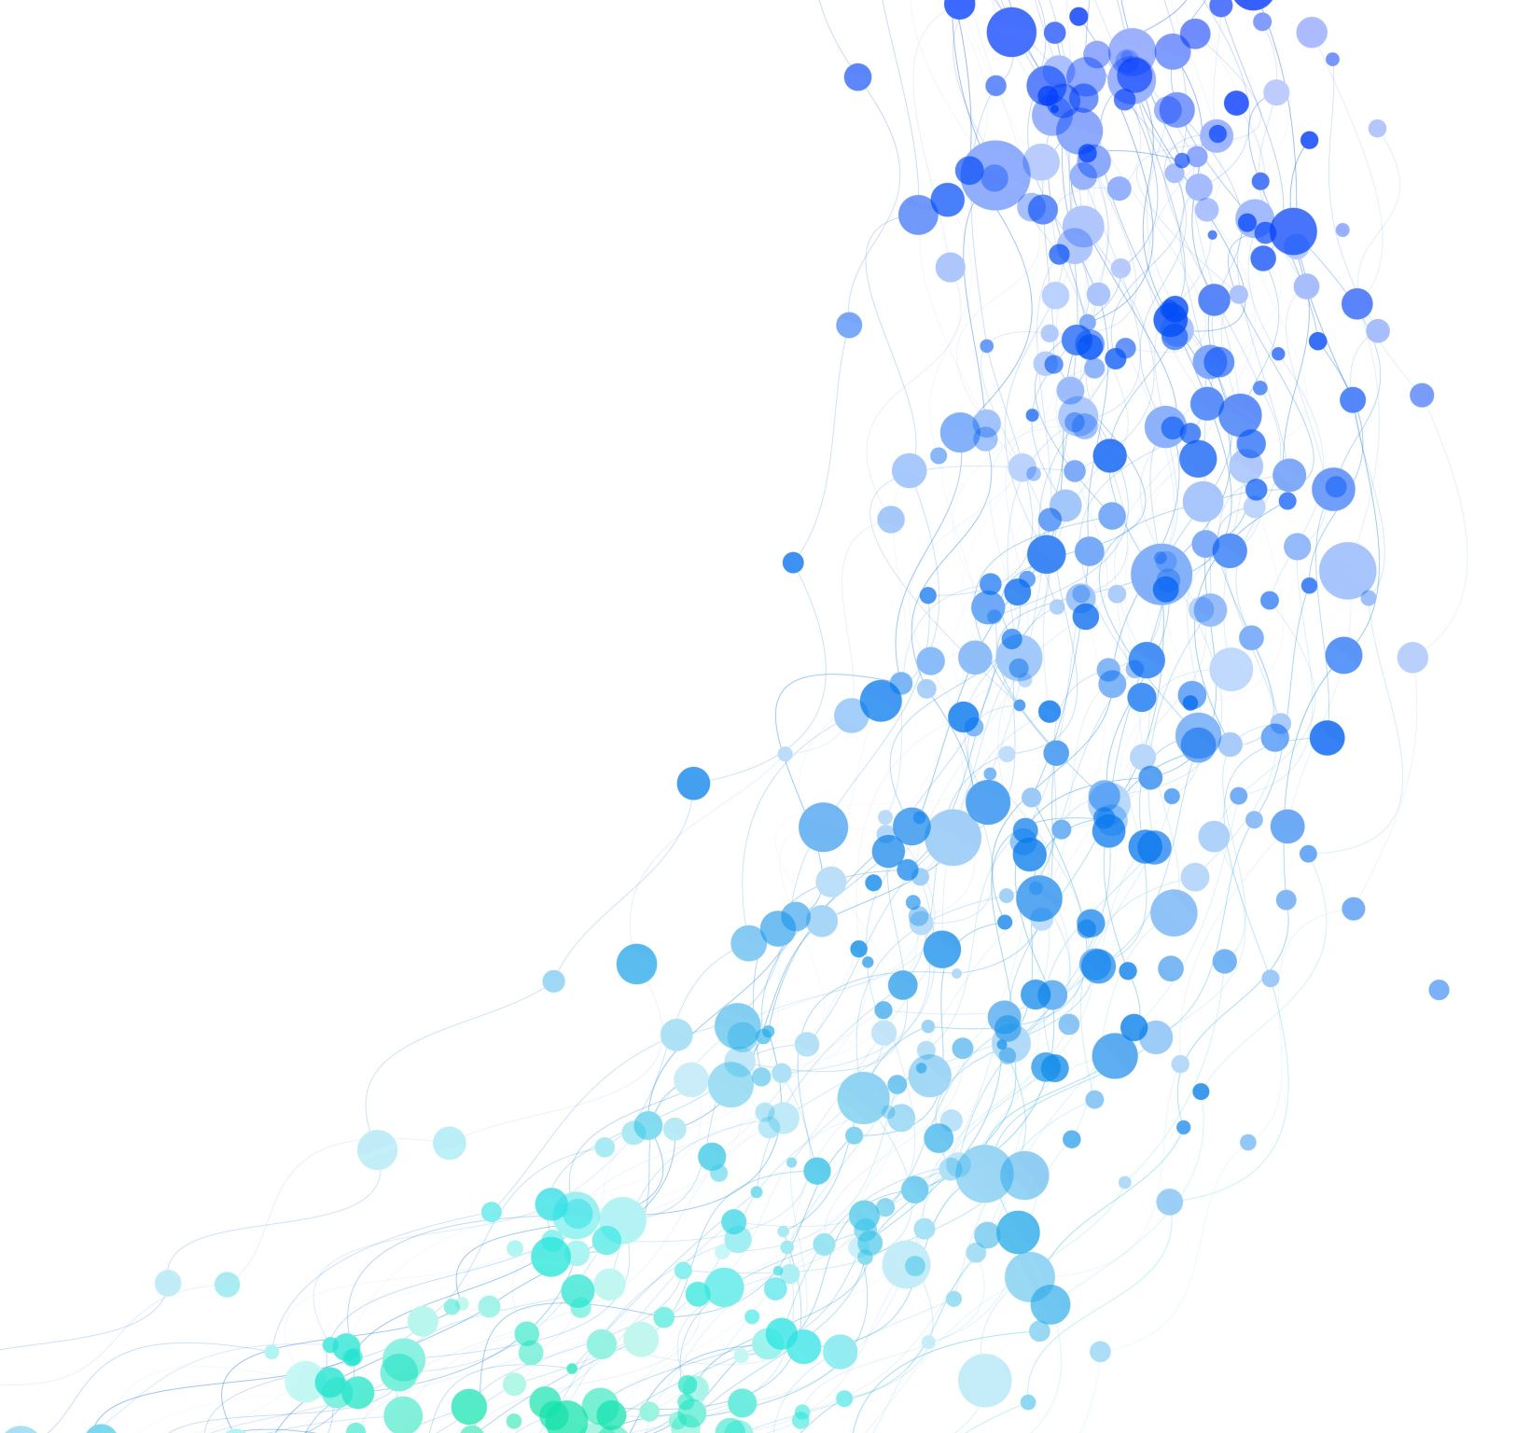
Many Body Post-Minkowski Simulation
Zackary Windham

Slide 2
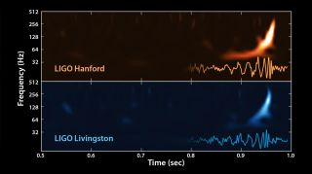
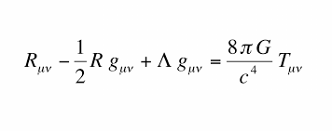
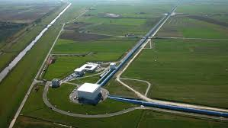
Gravitational Waves
The waveform from the first gravitational waves detected in 2015.

Slide 3
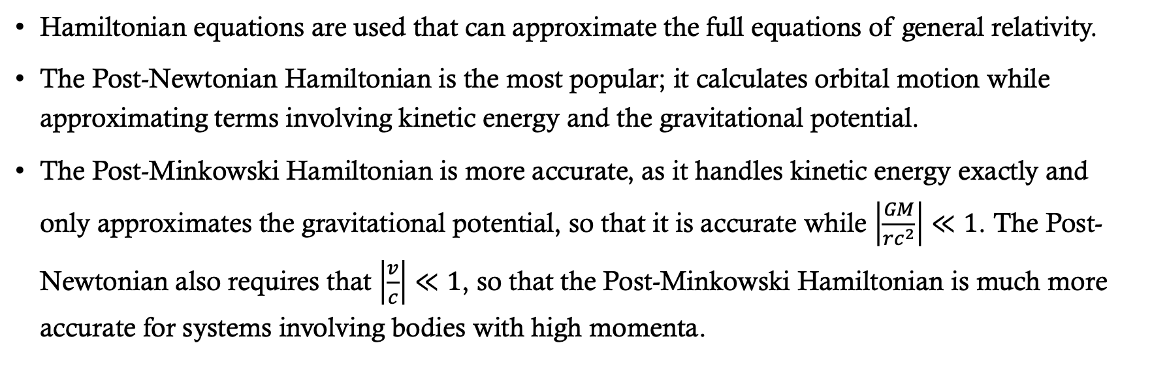
Post-Minkowski Approximation
Hamiltonian equations are used that can approximate the full equations of general relativity.
The Post-Newtonian Hamiltonian is the most popular; it calculates orbital motion while approximating terms involving kinetic energy and the gravitational potential.
The Post-Minkowski Hamiltonian is more accurate, as it handles kinetic energy exactly and only approximates the gravitational potential, so that it is accurate while $\left|\frac{GM}{rc^{2}}\right|≪1$. The Post-Newtonian also requires that $\left|\frac{v}{c}\right|≪1$, so that the Post-Minkowski Hamiltonian is much more accurate for systems involving bodies with high momenta.

Slide 4
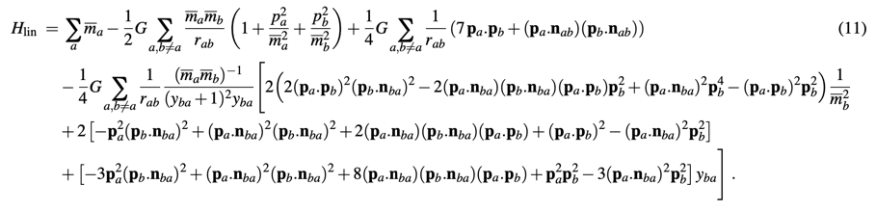
Post-Minkowski N-body Equation to First Order in G
We have written a code to solve this in equation in Julia, using their suite of advanced ODE solvers.

Slide 5
Problem of Initial Conditions
Correct initial conditions will produce a circular orbit. The example shown here is the animation of the orbital paths of two bodies with a mass ratio of 2.
What it should look like
What the code is producing

Slide 6
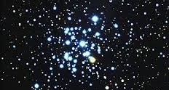
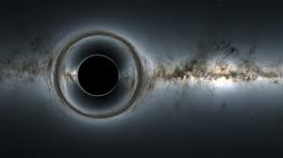
Up next

Slide 7
Examples

